Slide 1
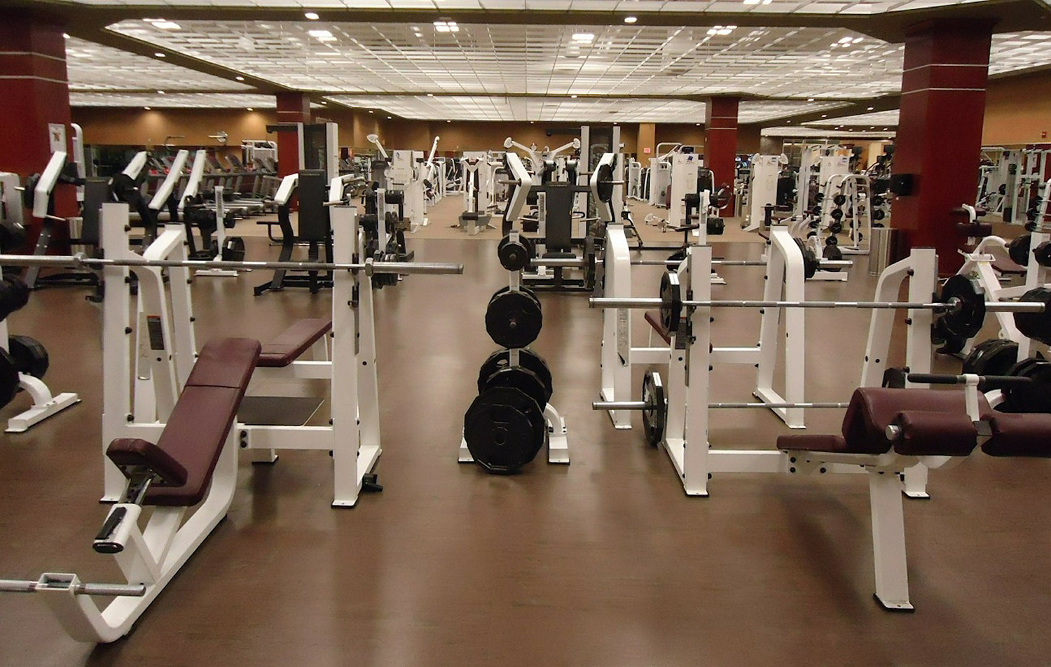
HEBRON APARTMENT-BASED GYM MANAGEMENT SYSTEM
CHRISTINE NYAWIRA GITONGA
BBIT 3.2
HDB212-D1-0697/2023
JOMO KENYATTA UNIVERSITY OF AGRICULTURE AND TECHNOLOGY
28/01/2026

Slide 2
INTRODUCTION
Modern apartments provide shared gym facilities to their residents
Managing data manually is prone to errors
Aim of this system is to offer high quality management of gym operations to ensure residents are provided with efficient, reliable, and a user-friendly system for managing membership, attendance and payments.

Slide 3
PROBLEM STATEMENT
Manual work leads to data loss and security breach, too much paperwork and redundancy , slow decision making, poor tracking of the clients’ subscription and billing charges, overloading the trainers with work and poor service delivery

Slide 4
OBJECTIVES OF THE SYSTEM
Improve service delivery
Automation of membership management the system ensures that the membership renewal of subscription, tracking the subscription status and handling of their personal data is securely done.
Payment management
Real-time tracking to minimize errors
Centralized communication between clients and trainers

Slide 5
SCOPE OF THE SYSTEM
Designed for apartment residential gyms
Used by gym administrators and residents
Handles member registration, subscription management, class scheduling, equipment tracking, and digital payments.

Slide 6
EXISTING SYSTEM
Manual registration of members
Unstructured payment methods
Tracking attendance on paper

Slide 7
PROPOSED SYSTEM
Digital membership registration
Automated tracking of attendance
Manageable payments and billing
Centralized communication between clients and trainers

Slide 8
SYSTEM USERS
Gym administrators manage the operations of the system, maintenance and schedules
Apartment residents use the gym services
Apartment management review reports

Slide 9
FUNCTIONAL REQUIREMENTS
User registration and log in
Membership registration
Attendance registration
Management of payment
Reports reviews
F

Slide 10
NON-FUNCTIONAL REQUIREMENTS
System security
User friendly interface
Fast response time
System reliability

Slide 11
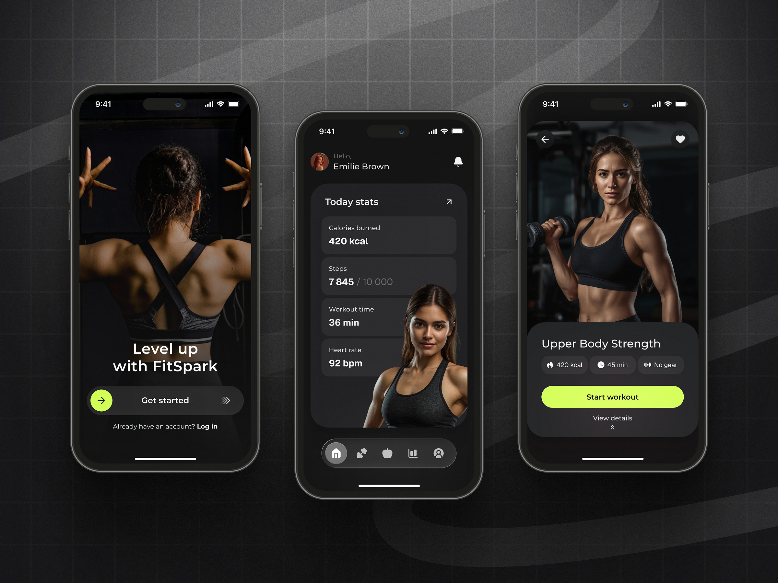

SYSTEM ARCHITECTURE
User interface: Mobile application (iOS/Android) and web portal
Backend: secure database. Client information logs
Hardware: door scanners for security
This Photo by Unknown Author is licensed under CC BY-SA-NC

Slide 12
BENEFITS OF THE SYSTEM
Reducing manual workload
Improves accuracy
Saves time
Customer satisfaction
Guaranteed safety and security
Increased value to the apartment

Slide 13
CONCLUSION
An apartment-based Gym management system provides solutions to managing apartment gym facilities through structured access control, scheduling and monitoring. The successful implementation benefits the residents and apartment management by improving service delivery, safety and accountability.
THANK YOU

